Slide 1
Food Donation Management System

Slide 2
Problem Statement:
A lot of food gets wasted, and it’s hard for organizations to keep track of donations from restaurants, households, or others. NGOs need these donations to help people, but without a proper system, food can expire, and donors’ contributions might not be recorded properly.
This system helps by keeping a record of donors, NGOs, and food donations, sending notifications when new donations or requests are made, and tracking the status of food so nothing goes to waste.

Slide 3
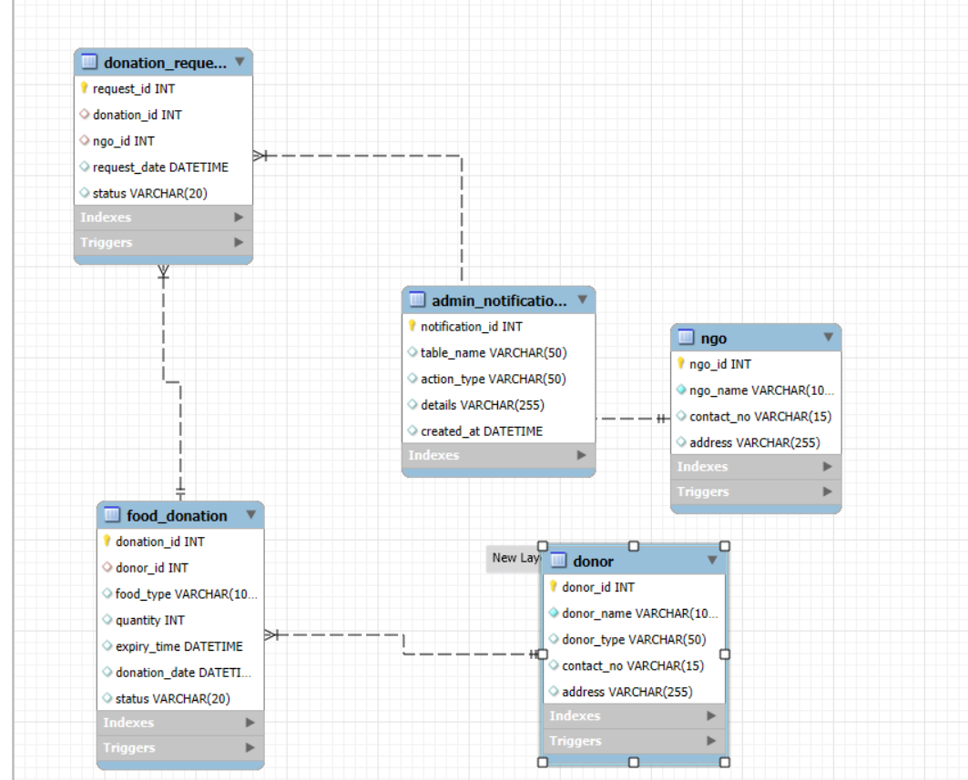
ER DIAGRAM:

Slide 4
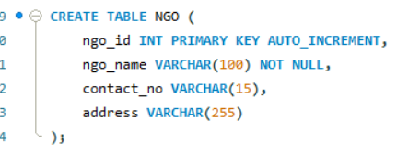
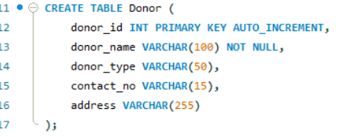
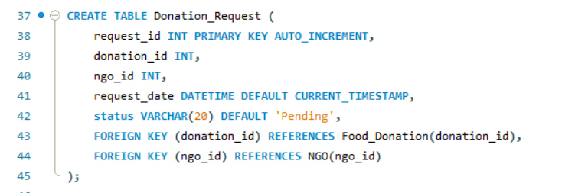
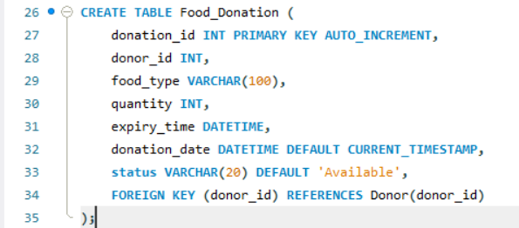
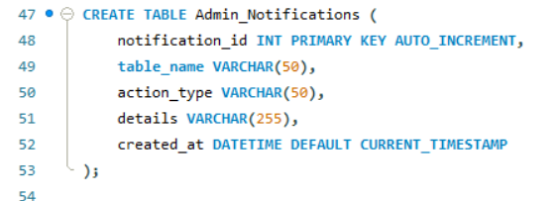
TABLE STRUCTURES:
Table 2 : NGO
Table 1 : Donor
Table 4 : Donation-Request
Table 3: Food Donation
Table 5 :Admin Notifications

Slide 5
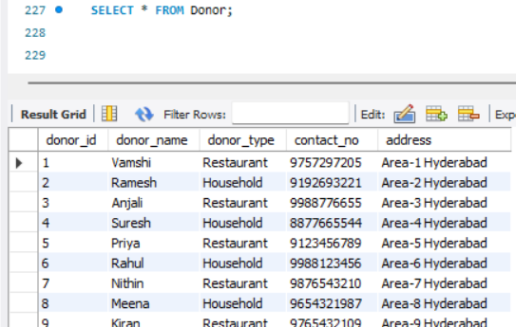
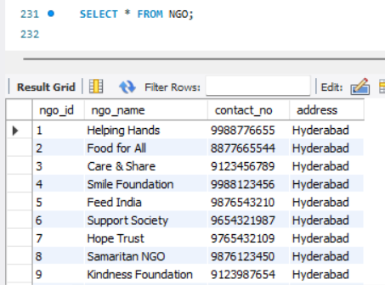
Queries:
1. Find all the Donors List? 2. Find all the Ngo list?

Slide 6
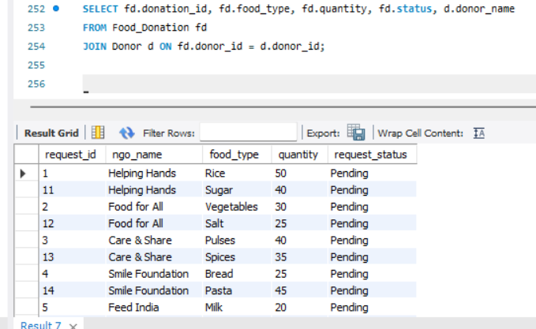
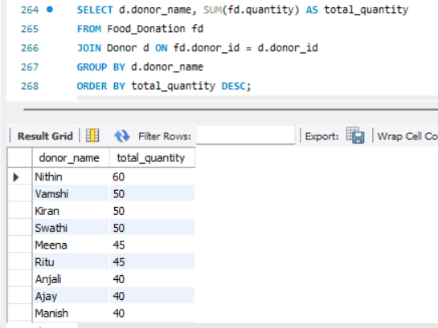
3.List all donation requests with NGO and donation details?
4. Total quantity of food donated by each donor

Slide 7
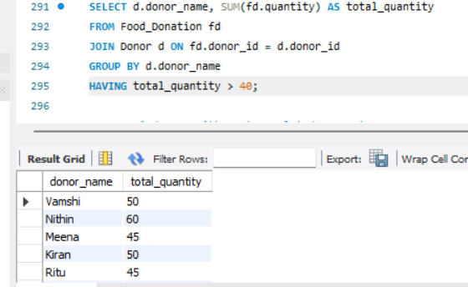
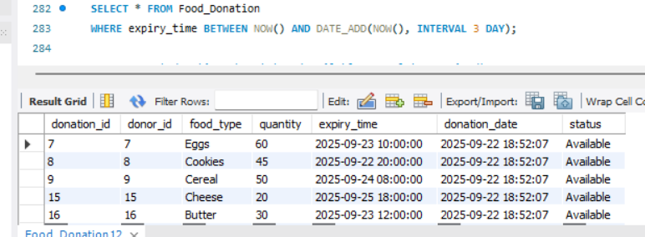
5.Find donors who have donated more than 40 units in total?
6. List donations that will expire in the next 3 days

Slide 8
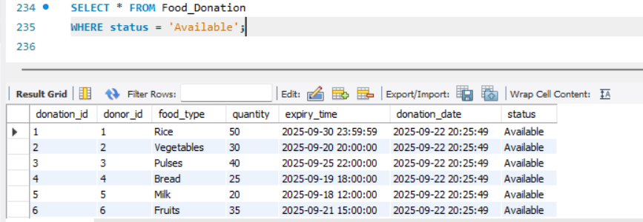
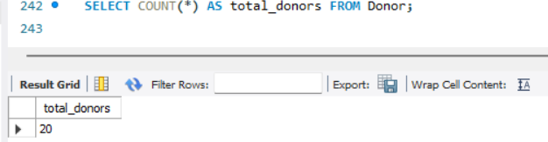
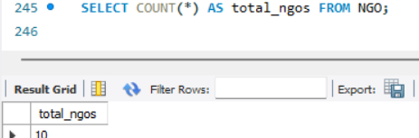
7. Select all food donations that are still available?
8. Count total number of donors
9. Count total number of NGOs

Slide 9
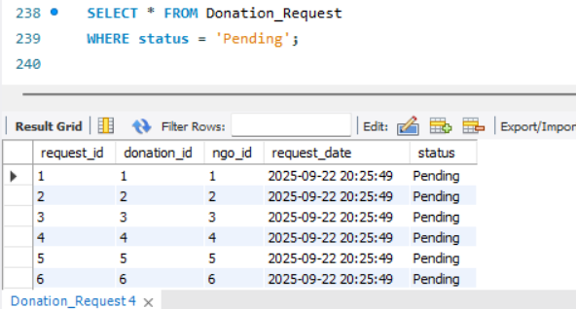
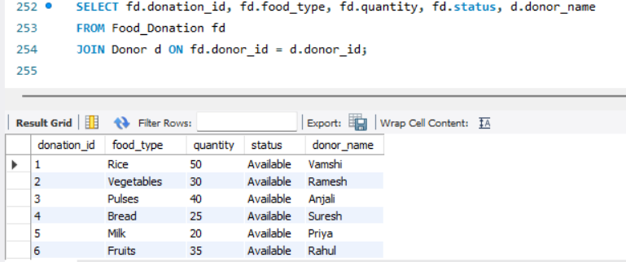
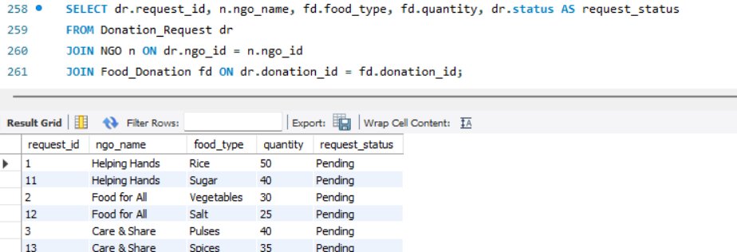
10. Select all donation requests that are pending
11. List all donations along with donor name
12. List all donation requests with NGO and donation details

Slide 10
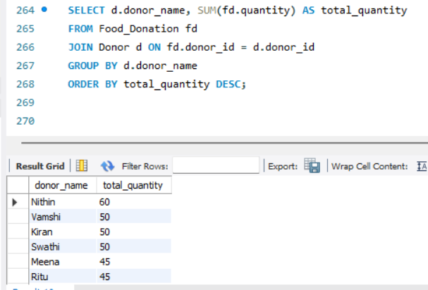
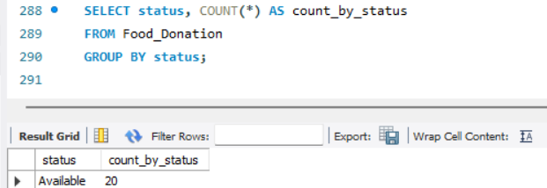
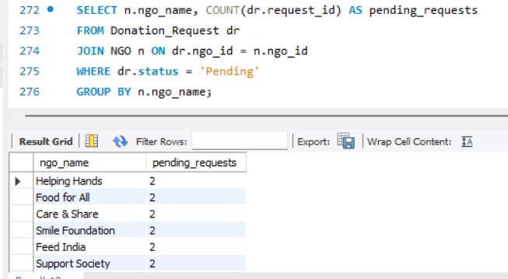
13. Total quantity of food donated by each donor
15. Count donations by status (Available, Complete, Expired)
14. Total pending requests for each NGO

Slide 11
Insights:
NGOs like Smile Foundation & Care & Share show consistent request activity.
20 donors registered → mix of Restaurants & Households.
Restaurants donate in bulk (rice, pulses, oil, eggs).
Households contribute smaller but diverse items (fruits, bread, vegetables).
Top Donors (by total quantity):
Vamshi (Rice – 50 units)
Nithin (Eggs – 60 units)
Anjali (Pulses – 40 units)

Slide 12
Conclusion:
The Food Donation Management System makes it easy to manage food donations. It:
Tracks donations and requests in real time.
Sends alerts for new donors, NGOs, and donations.
Marks expired food automatically to prevent wastage.
Shows useful reports like top donors or pending requests.
Overall, it helps food reach the people who need it faster and without waste, while keeping everything organized.

Slide 13

THANK YOU

